Slide 1
IPv6 Addressing & Subnetting
6/4/2015

Slide 2
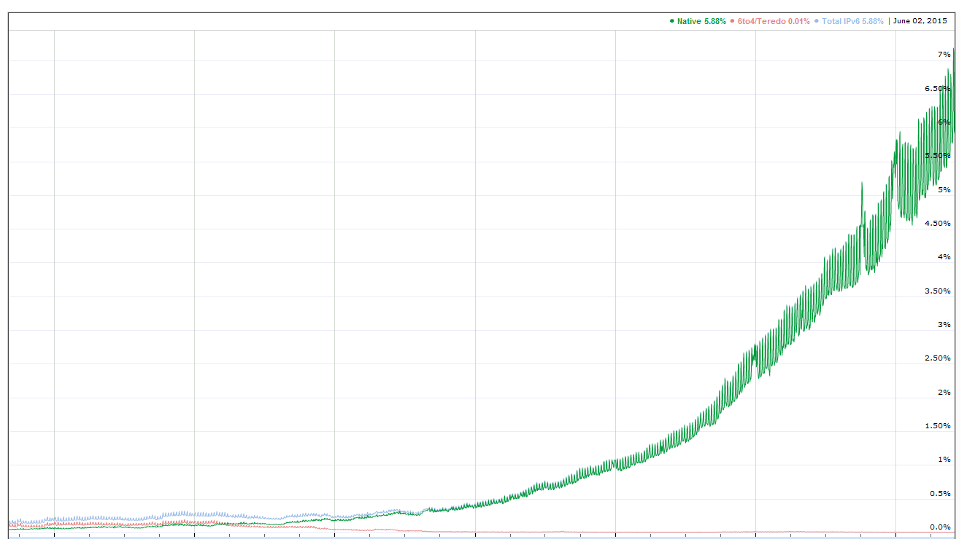
IPV6 Adoption
7%
6%
5%
4%
3%
2%
1%
0
Source: https://www.google.com/intl/en/ipv6/statistics.html#tab=ipv6-adoption
2009 2010 2011 2012 2013 2014 2015

Slide 3
IPv4 Address
32-bits / Four blocks of 8 bits
Period-separated
10101100.10000000.00000000.00010011

Slide 4
IPv4 Address
32-bits / Four blocks of 8 bits
Period-separated
10101100.10000000.00000000.00010011
172 . 128 . 0 . 19
Expressed as four decimal numbers
Each 0 to 255

Slide 5
IPv6 Address
128-bits / 8 blocks of 16 bits
Colon-separated
1000000101000101:0000000100001100:0000000000000000:0000000000000000:0001000100000000:0001101000000110:1000100000000000:0000000000000001

Slide 6
IPv6 Address
128-bits / 8 blocks of 16 bits
Colon-separated
1000000101000101:0000000100001100:0000000000000000:0000000000000000:0001000100000000:0001101000000110:1000100000000000:0000000000000001
X:X:X:X:X:X:X:X
where each X represents 16 bits

Slide 7
IPv6 Address
128-bits / 8 blocks of 16 bits
Colon-separated
1000000101000101:0000000100001100:0000000000000000:0000000000000000:0001000100000000:0001101000000110:1000100000000000:0000000000000001
8145 : 010C : 0000 : 0000 : 1100 : 1A06 : 8800 : 0001
Expressed as 8 groups of 4 hexadecimal digits
Each 0 to FFFF

Slide 8
Binary – Hex Conversion
Hex | Binary | Dec
0 | 0000 | 0
1 | 0001 | 1
2 | 0010 | 2
3 | 0011 | 3
4 | 0100 | 4
5 | 0101 | 5
6 | 0110 | 6
7 | 0111 | 7
8 | 1000 | 8
9 | 1001 | 9
A | 1010 | 10
B | 1011 | 11
C | 1100 | 12
D | 1101 | 13
E | 1110 | 14
F | 1111 | 15
0001101000000110 => Hexadecimal
Four binary digits = one Hex digit

Slide 9
Binary – Hex Conversion
Hex | Binary | Dec
0 | 0000 | 0
1 | 0001 | 1
2 | 0010 | 2
3 | 0011 | 3
4 | 0100 | 4
5 | 0101 | 5
6 | 0110 | 6
7 | 0111 | 7
8 | 1000 | 8
9 | 1001 | 9
A | 1010 | 10
B | 1011 | 11
C | 1100 | 12
D | 1101 | 13
E | 1110 | 14
F | 1111 | 15
0001101000000110 => Hexadecimal
Four binary digits = one Hex digit
0001 1010 0000 0110

Slide 10
Binary – Hex Conversion
Hex | Binary | Dec
0 | 0000 | 0
1 | 0001 | 1
2 | 0010 | 2
3 | 0011 | 3
4 | 0100 | 4
5 | 0101 | 5
6 | 0110 | 6
7 | 0111 | 7
8 | 1000 | 8
9 | 1001 | 9
A | 1010 | 10
B | 1011 | 11
C | 1100 | 12
D | 1101 | 13
E | 1110 | 14
F | 1111 | 15
0001101000000110 => Hexadecimal
Four binary digits = one Hex digit
0001 1010 0000 0110
1 A 0 6

Slide 11
Binary – Hex Conversion
Hex | Binary | Dec
0 | 0000 | 0
1 | 0001 | 1
2 | 0010 | 2
3 | 0011 | 3
4 | 0100 | 4
5 | 0101 | 5
6 | 0110 | 6
7 | 0111 | 7
8 | 1000 | 8
9 | 1001 | 9
A | 1010 | 10
B | 1011 | 11
C | 1100 | 12
D | 1101 | 13
E | 1110 | 14
F | 1111 | 15
0001101000000110 => Hexadecimal
Four binary digits = one Hex digit
0001 1010 0000 0110
1 A 0 6
Digit weight →
8 4 2 1
0 0 0 0

Slide 12
Binary – Hex Conversion
Hex | Binary | Dec
0 | 0000 | 0
1 | 0001 | 1
2 | 0010 | 2
3 | 0011 | 3
4 | 0100 | 4
5 | 0101 | 5
6 | 0110 | 6
7 | 0111 | 7
8 | 1000 | 8
9 | 1001 | 9
A | 1010 | 10
B | 1011 | 11
C | 1100 | 12
D | 1101 | 13
E | 1110 | 14
F | 1111 | 15
01001100 => Hexadecimal
Four binary digits = one Hex digit
Digit weight →
8 4 2 1
0 0 0 0
Not case sensitive

Slide 13
IPv6 Address – Zero Suppression
8145 : 010C : 0000 : 0000 : 1100 : 1A06 : 8800 : 0001

Slide 14
IPv6 Address – Zero Suppression
8145 : 010C : 0000 : 0000 : 1100 : 1A06 : 8800 : 0001
Trim leading zeros

Slide 15
IPv6 Address – Zero Suppression
8145 : 010C : 0000 : 0000 : 1100 : 1A06 : 8800 : 0001
Trim leading zeros
8145 : 10C : 0 : 0 : 1100 : 1A06 : 8800 : 1

Slide 16
IPv6 Address – Zero Compression
8145 : 10C : 0 : 0 : 1100 : 1A06 : 8800 : 1

Slide 17
IPv6 Address – Zero Compression
8145 : 10C : 0 : 0 : 1100 : 1A06 : 8800 : 1
Hide consecutive all-zero blocks

Slide 18
IPv6 Address – Zero Compression
8145 : 10C : 0 : 0 : 1100 : 1A06 : 8800 : 1
Hide consecutive all-zero blocks (only 1)
8145 : 10C : : 1100 : 1A06 : 8800 : 1

Slide 19
IPv6 Address – Simplified
8145 : 010C : 0000 : 0000 : 1100 : 1A06 : 8800 : 0001
8145:10C::1100:1A06:8800:1

Slide 20
IPv6 Address
8145 : 010C : 0000 : 0000 : 1100 : 1A06 : 8800 : 0001
64-bits
Network portion
64-bits
Host portion

Slide 21
IPv6 Address – Simplified
CIDR Notation
(Classless Inter Domain Routing)
8145:10C::1100:1A06:8800:1/64

Slide 22
IPv6 Address
8145 : 010C : 0000 : 0000 : 1100 : 1A06 : 8800 : 0001
48-bits
Network
16-bits
Subnet
64-bits
Host portion

